Slide 1
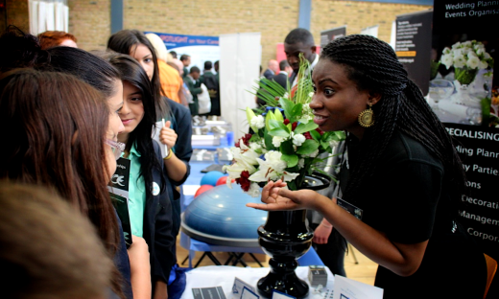
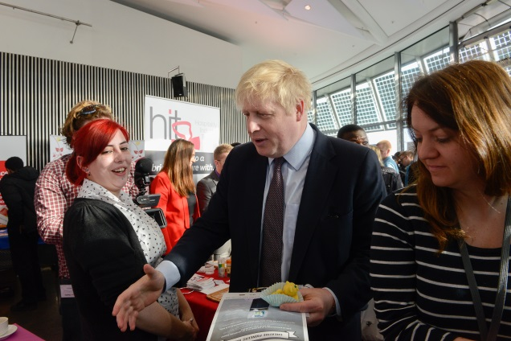
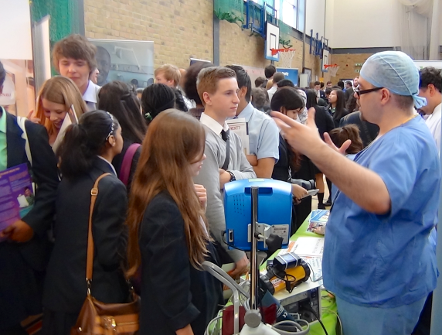
How young people and schools benefit from effective partnerships between education and employers
www.inspiringthefuture.org.au

Slide 2
A not-for-profit incorporated association based in Western Sydney and established in 1995 with the express purpose of supporting education and career pathways for young people.
We believe that every young person has a gift or talent inside them.
We work with young people to help them discover their career passion and how to transform their skills leading to real jobs.
Notes:
Context;
Charity set up to ensure every school has an effective partnership with employers- COMPLETELY FREE SERVICE TO SCHOOLS
A lot of debate at the moment around careers in schools.
Ofsted report due in June.
Minister responded to a report on Tuesday add a quick synopsis.

Slide 3
What we do:
We bring purpose and meaning to education through targeted partnerships between employers, schools and the community through free services and programs such as:
Australia
Working in partnership with Education & Employers charity (UK) and with employers and schools across Australia
The NSW Government funded Work Placement program and
The Federally funded Transition to Work service for selected areas of Western Sydney, the Blue Mountains and the Hawkesbury regions

Slide 4
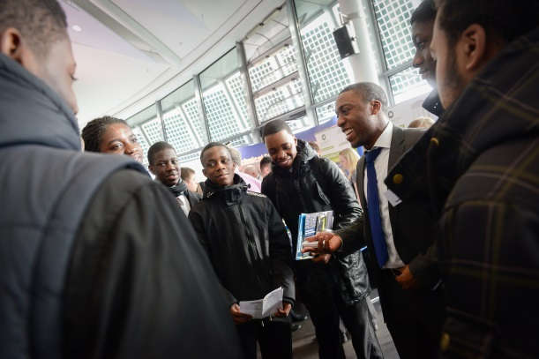
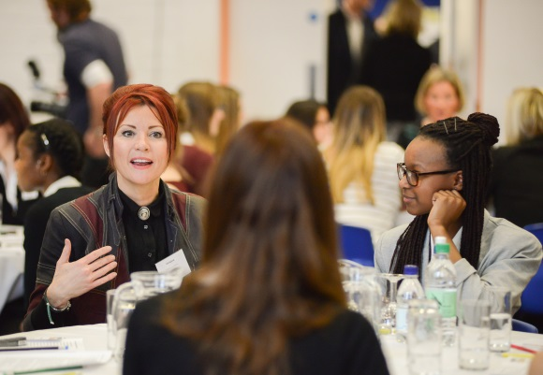
What is Inspiring the Future Australia?
Inspiring the Future Australia is a FREE service whereby employees from all sectors and professions from Apprentices to CEOs pledge one hour a year to volunteer to go into Australian schools and colleges to talk about their jobs, careers, and the education routes they took
It is a FREE service delivered in Australia by Schools Industry Partnership building on the enormous success of Inspiring the Future in the UK over the past three years where is has been endorsed by Government (with cross-party support), the UK’s main teacher and employer representative organisations and many leading employers.
It makes a difference to young people. Good quality research shows that who you meet as a teenager shapes the success with which young people go into adult life
Teachers overwhelmingly want young people to hear more from people in the workplace

Slide 6
Education & Employers Taskforce/YouGov 2011 UK survey, 986 young adults (19-24):
Q1: How many different occasions do you remember employer involvement (work experience, mentoring, enterprise competitions, career advice, Resume or interview practice) when you were at school?
The Supporting Research
Number of Occasions | 0 | 1 | 2 | 3 | 4 or more
NEET | 26% | 23% | 17% | 16% | 4%
Source: It’s who you meet, 2012

Slide 7
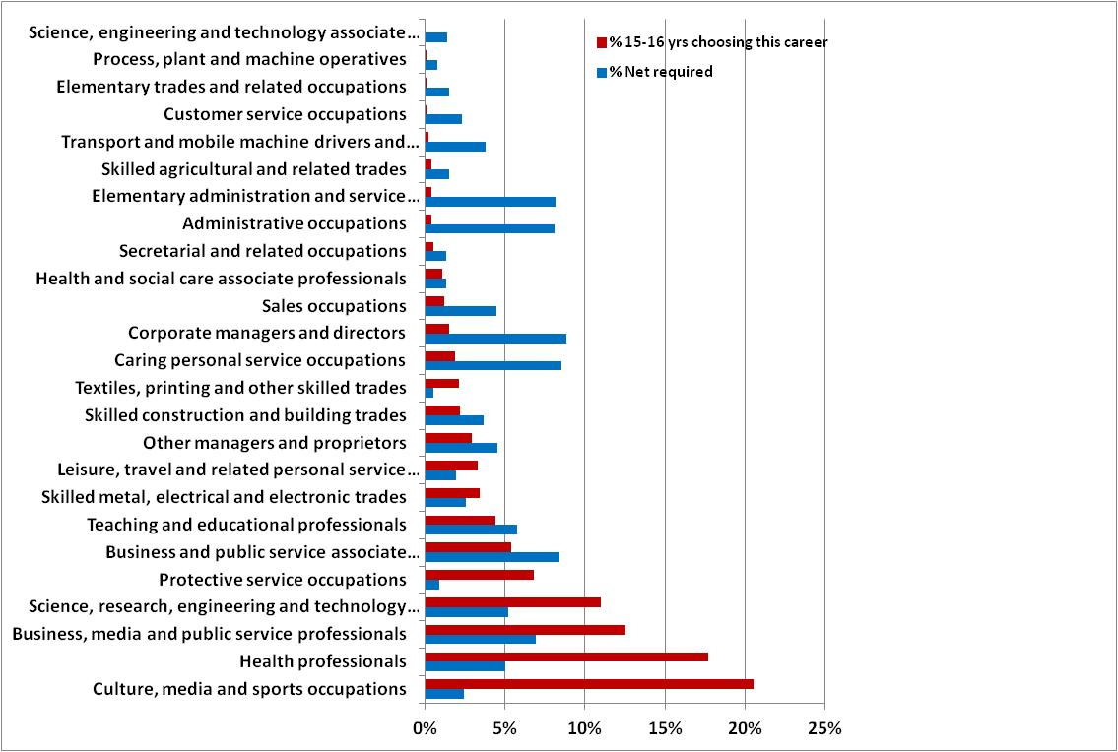
...against teenage aspirations (UK)

Slide 8
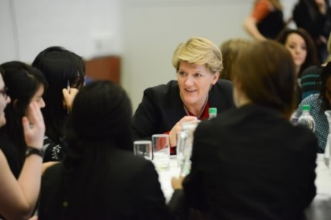
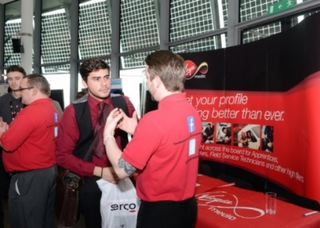
Benefits for Schools and Colleges
Thousands of diverse volunteers waiting for teachers to invite them to talk to their pupils about their jobs, and the routes they took to get there, or even resume and interview insights at the click of a button
How does it work
When teaching staff log on to the system, they get a list of all those people registered in their area who can speak to young people about different specialisms and activities, and it’s a simple process to send a message through the system to get in touch
Specialisms
Apprenticeships
Design and Manufacturing
Enterprise/Entrepreneurs
Maths – Using it at work
Science and Technology
Languages – French, German, Italian, Spanish, Russian, Mandarin, Japanese, Urdu, Arabic

Slide 9
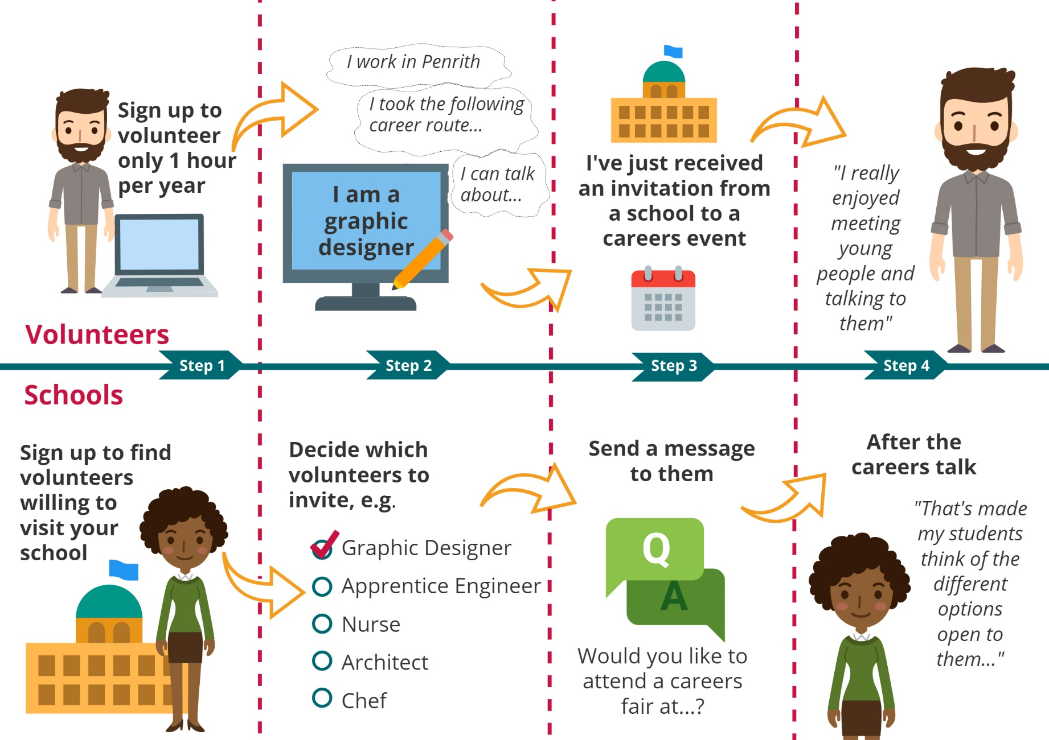

Slide 10
Current Volunteer Activities:
Career Insight Talks and Events- speaking to groups of young people about your career journey and education pathway, and what work you do now. -providing information on skill requirements and possible education pathways that lead to future employment in your industry. You could do this by offering students short careers talks including a Q&A session, presenting at a career fair, or participating in events such as Speed Career Networking and ‘What’s my Line” or being involved in an ‘Inspiring Futures for Young Women’ activity.
Curriculum Link- involving yourself in consultations with teachers who seek to enrich school curriculum by offering your input to students so they can develop an appreciation of how their academic and vocational school subjects and learning activities are relevant to and are being applied in your career, workplace and industry.
Help with Resumes and/or Realistic Mock Interviews – giving young people feedback and advice on their Resumes – helping young people practice their communication skills in realistic mock interview scenarios for jobs, Apprenticeships, Higher Education entry etc.
Exchanging Expectations- enabling the voices of employers and young people to be shared and heard through authentic career conversations. In practical terms, this means a pair or small group of young people sitting down with you (as an employer/ee) and discussing what you both hope for and expect from each other. Young people and employers learning together, will help young workers (including students on placement) and their supervisors to be both more fulfilled and productive in their work.
Reading or Numeracy – reading to children or listening to them read in a primary school, either individually or in groups. This could be a one-off activity or it may evolve into more regular involvement depending on the needs of the school and availability of the volunteer.
- taking part in a numeracy related activity with a group of primary school children.

Slide 11
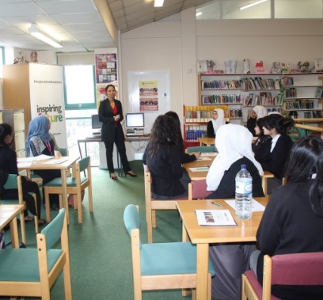
Types of Events – Schools/Colleges use ITF for
Careers Networking
Careers Fair
Talk
Types of Events you could run
Careers Fairs
Careers Networking
Options Evenings
‘Career Insight’ Talks
Resume & Interview Technique Workshops
What’s my line?
‘Enterprise Insight Talks’
School Assemblies
Curriculum Enrichment
Lunchtime Events

Slide 12
Our Campaigns

Slide 13
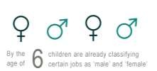
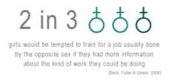
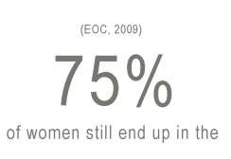
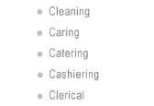
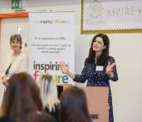
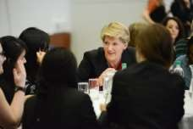
The Inspiring the Future: Inspiring Women campaign in the UK has seen over 18,000 inspirational women going into schools, talking to girls to broaden their horizons and raise aspirations

Slide 14
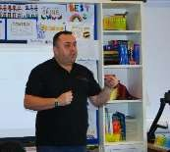
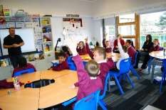
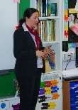
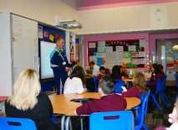
Inspiring the Future: Primary Futures
• Primary school project working under the banner of 'Inspiring the Future'
• Innovative approaches which allow primary schools to easily engage volunteers to
work with primary aged children.
• Volunteers can talk about their current job and why reading and numeracy in their primary school days were so important in achieving their current status
"We need to give our children and young people a vision of the opportunities available to them, so that they understand the value of learning and in doing so raise aspirations. It is never too soon to start this. We also need better connections between schools and the communities and businesses they work with.”
Russell Hobby, NAHT General Secretary (National Association of Head Teachers- UK)

Slide 15
Registering as a teacher

Slide 16
Signing up is quick and easy
Complete your profile
This will take you to the Inspiring the Future portal, where you will be asked to provide a few basic details, and your email address. Once your registration is approved, you will receive an email containing a temporary password. When you log in using this password, you will be asked to change it to something more memorable. On first entering the portal, we’ll ask you to provide a few more details about yourself, and what you need as a school/governor.
Activities you need help with
You’ll be asked to select activities that you need help with, for schools this is currently – Career insight talks and events, Curriculum link, Help with Resume’s and/or Realistic mock interviews, Exchanging expectations, Reading or numeracy
Find volunteers to invite
To find volunteers, schools go to ‘Find Volunteers’ once logged in, and generate a list of volunteers in their area who can offer the activity specified. Schools can view brief profiles of the volunteers including their jobs, and what they can offer. (Private email addresses and phone numbers are not visible to either party).
Send invite messages
From the ’Find Volunteers’ page, you can message appropriate volunteers and ask them to get involved in an activity they have coming up either individually or on mass. Volunteers accept/decline the event.
After the Event/Activity
If accepted, once it has taken place schools complete automated feedback forms. We ask four or five questions about how the event went. We strongly recommend that this is completed, as it allows us to keep an eye of the quality of volunteers and whether the service is working for both parties. We also use your feedback to report to funders, which will help to keep this service completely free to schools and volunteers

Slide 17
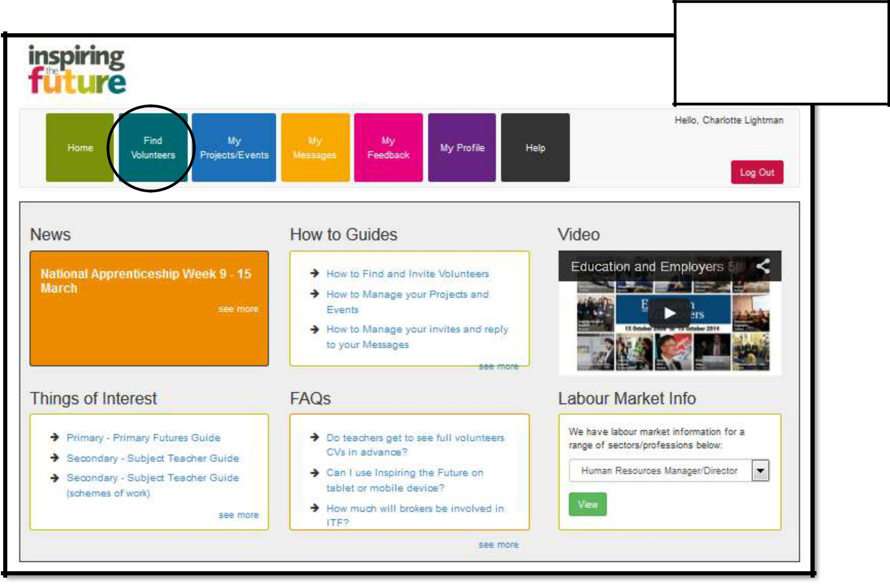
Login and click the
‘potential Find Volunteers’ tab to find volunteers

Slide 18
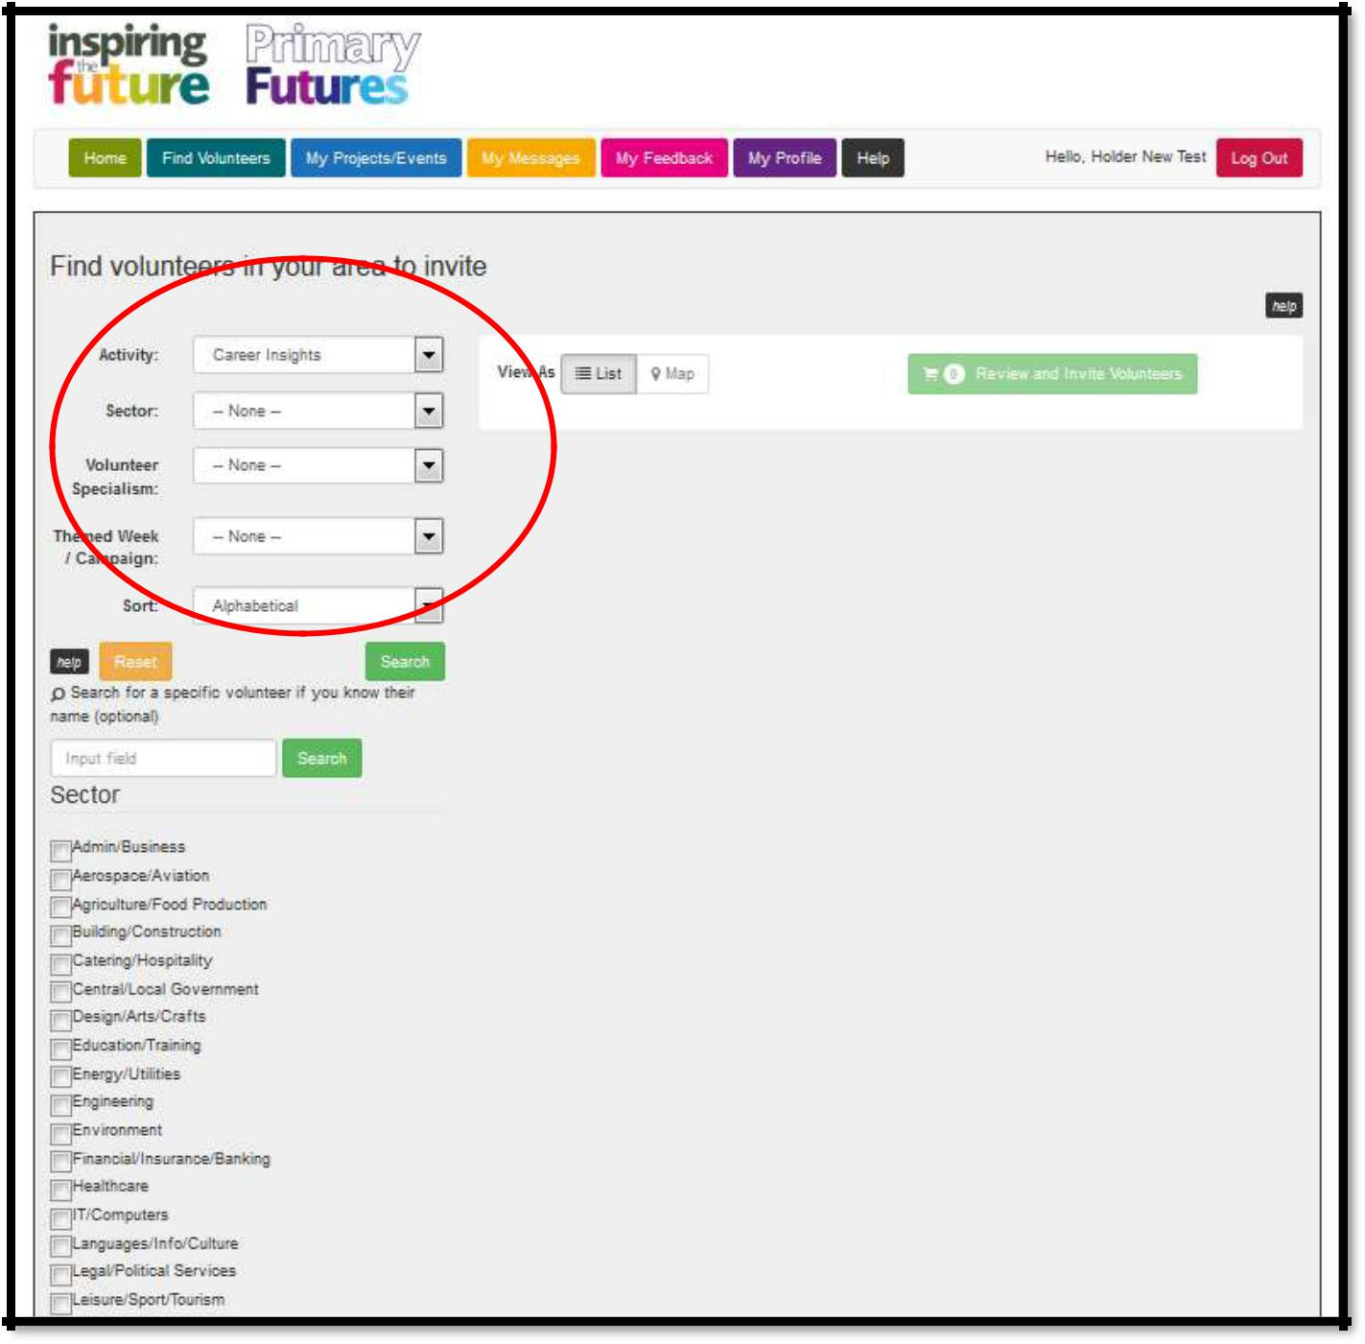
Search for volunteers

Slide 19
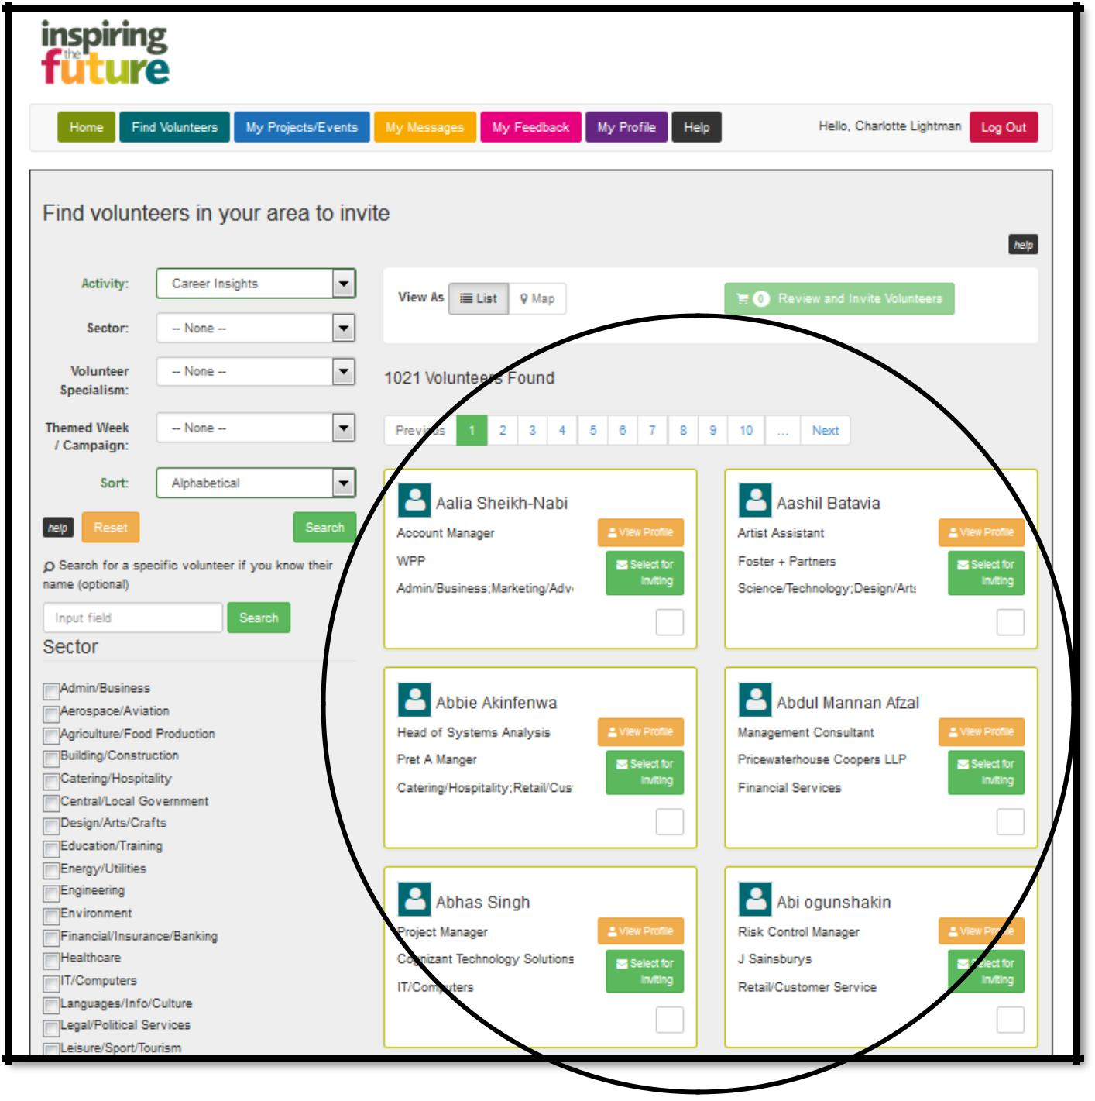
Viewing potential matches

Slide 20
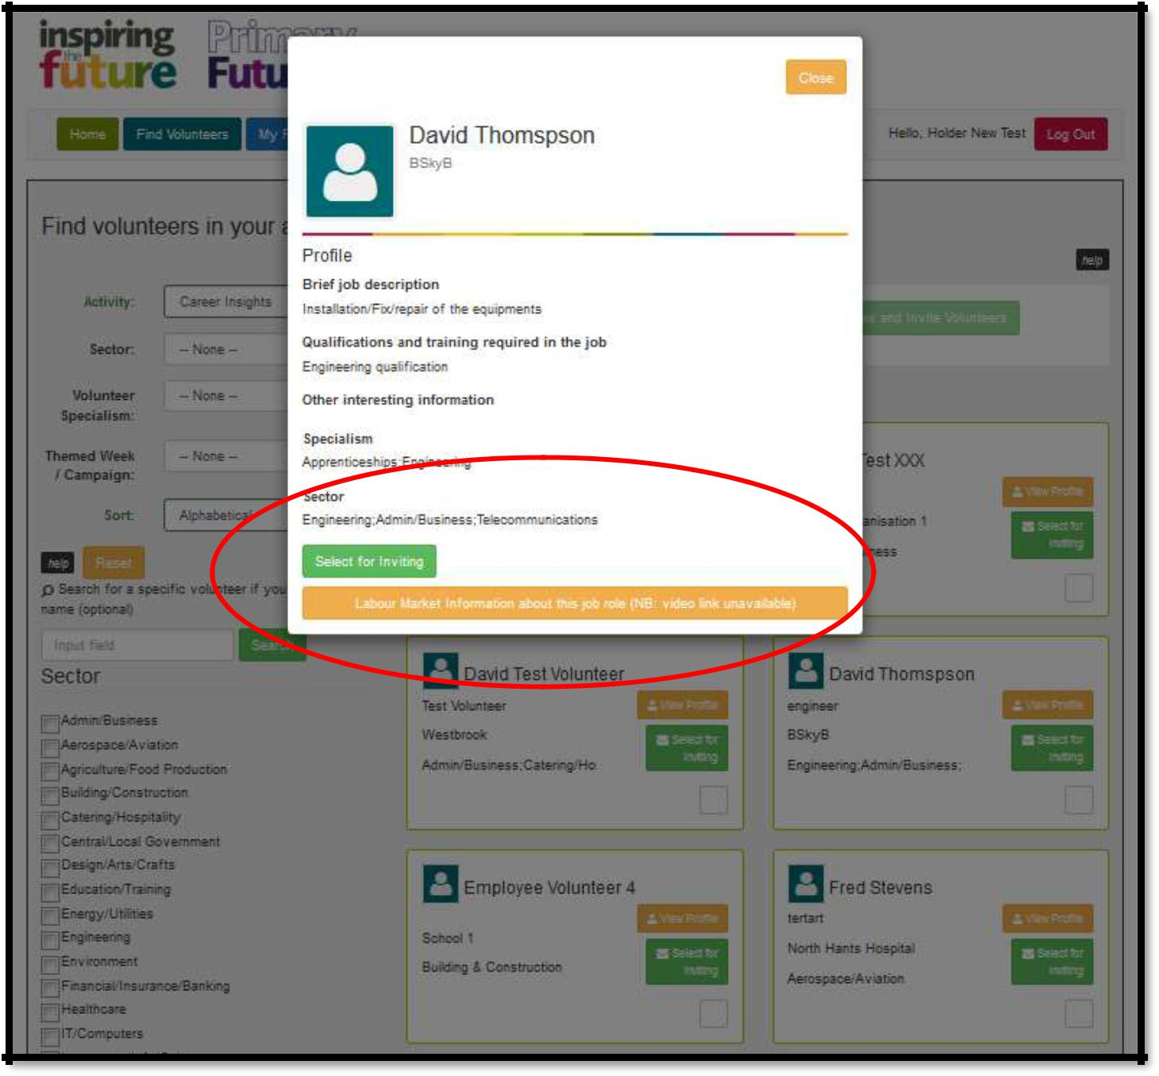
Viewing a volunteers full profile

Slide 21
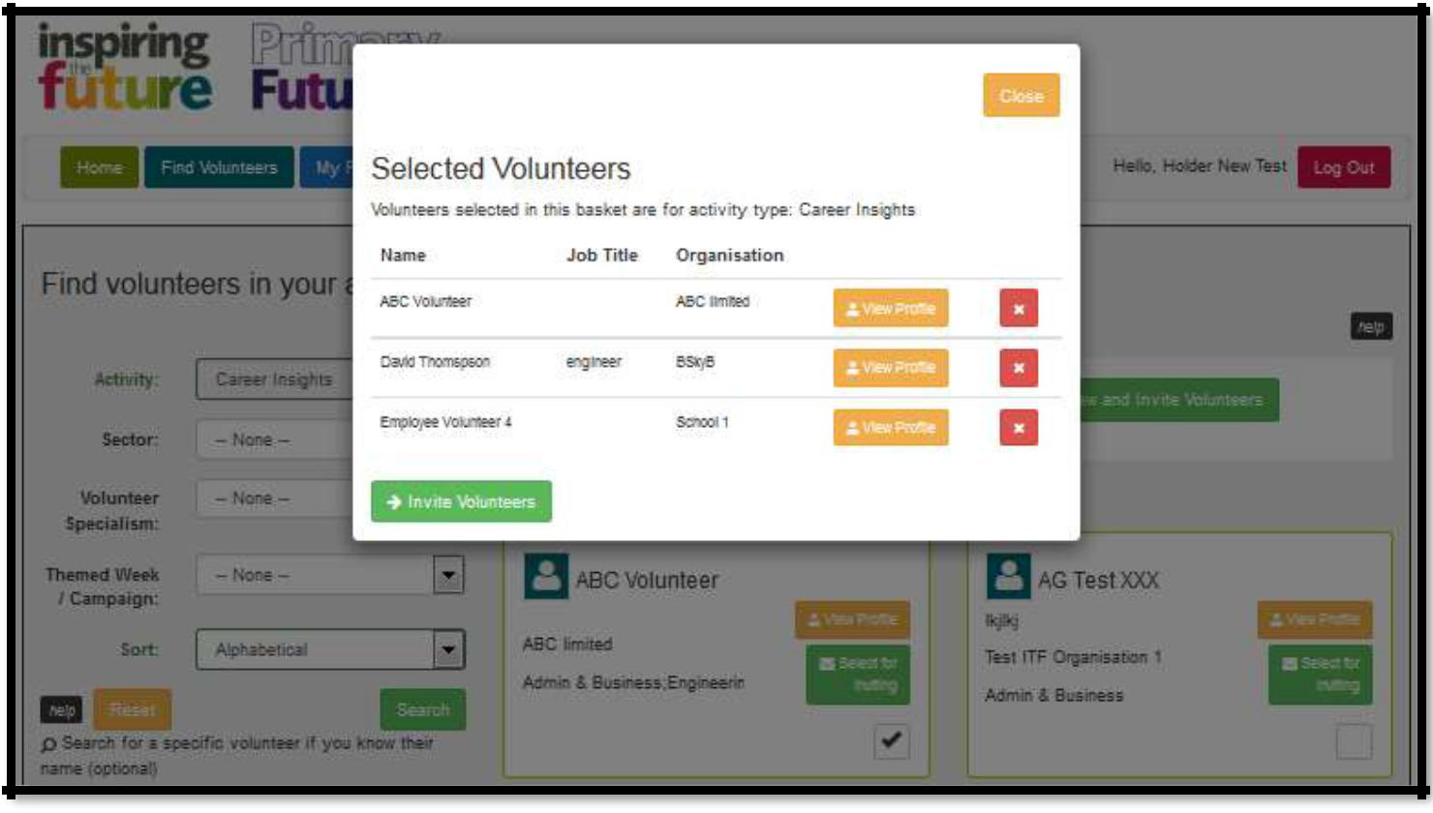
Review and Invite Selected Volunteers

Slide 22
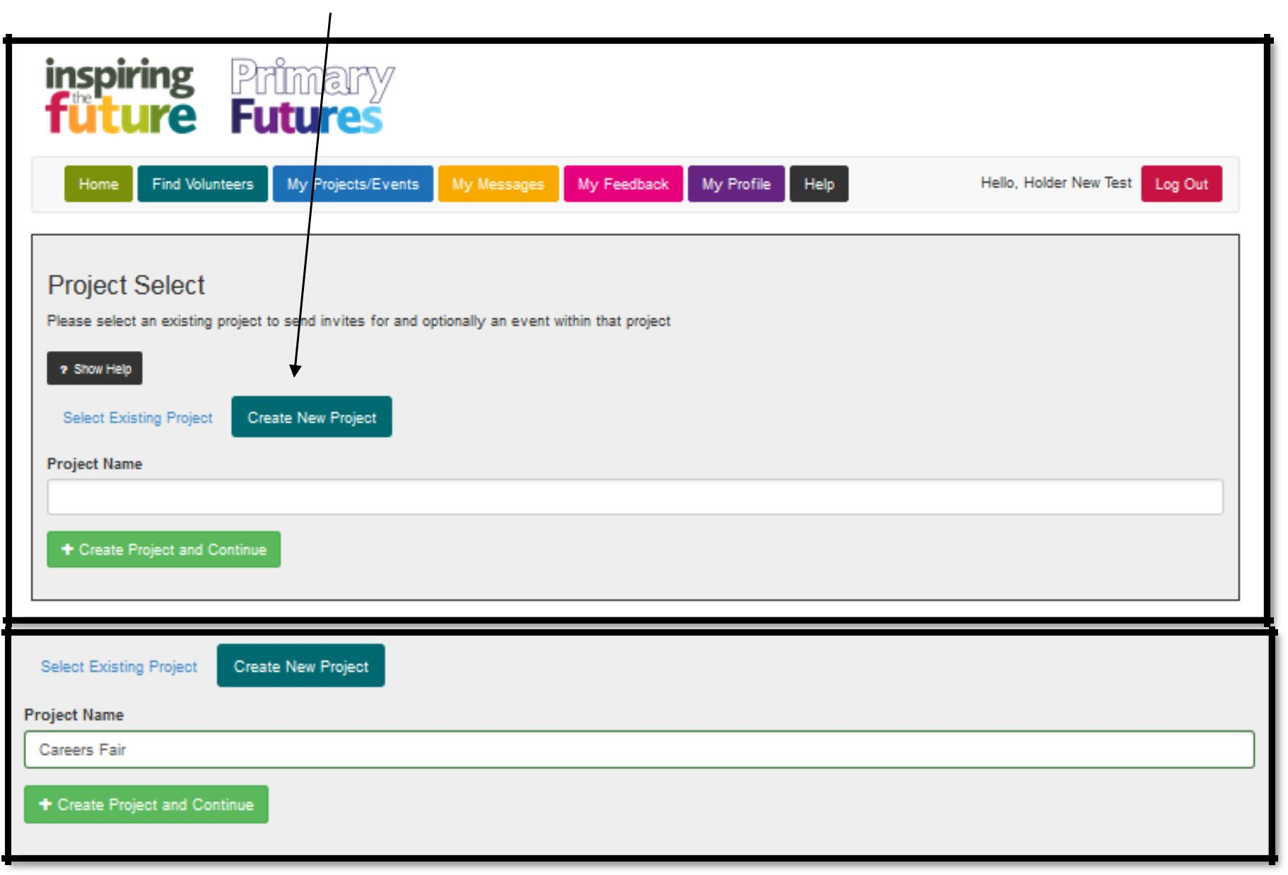
Adding Volunteers to a new Project/Event

Slide 23
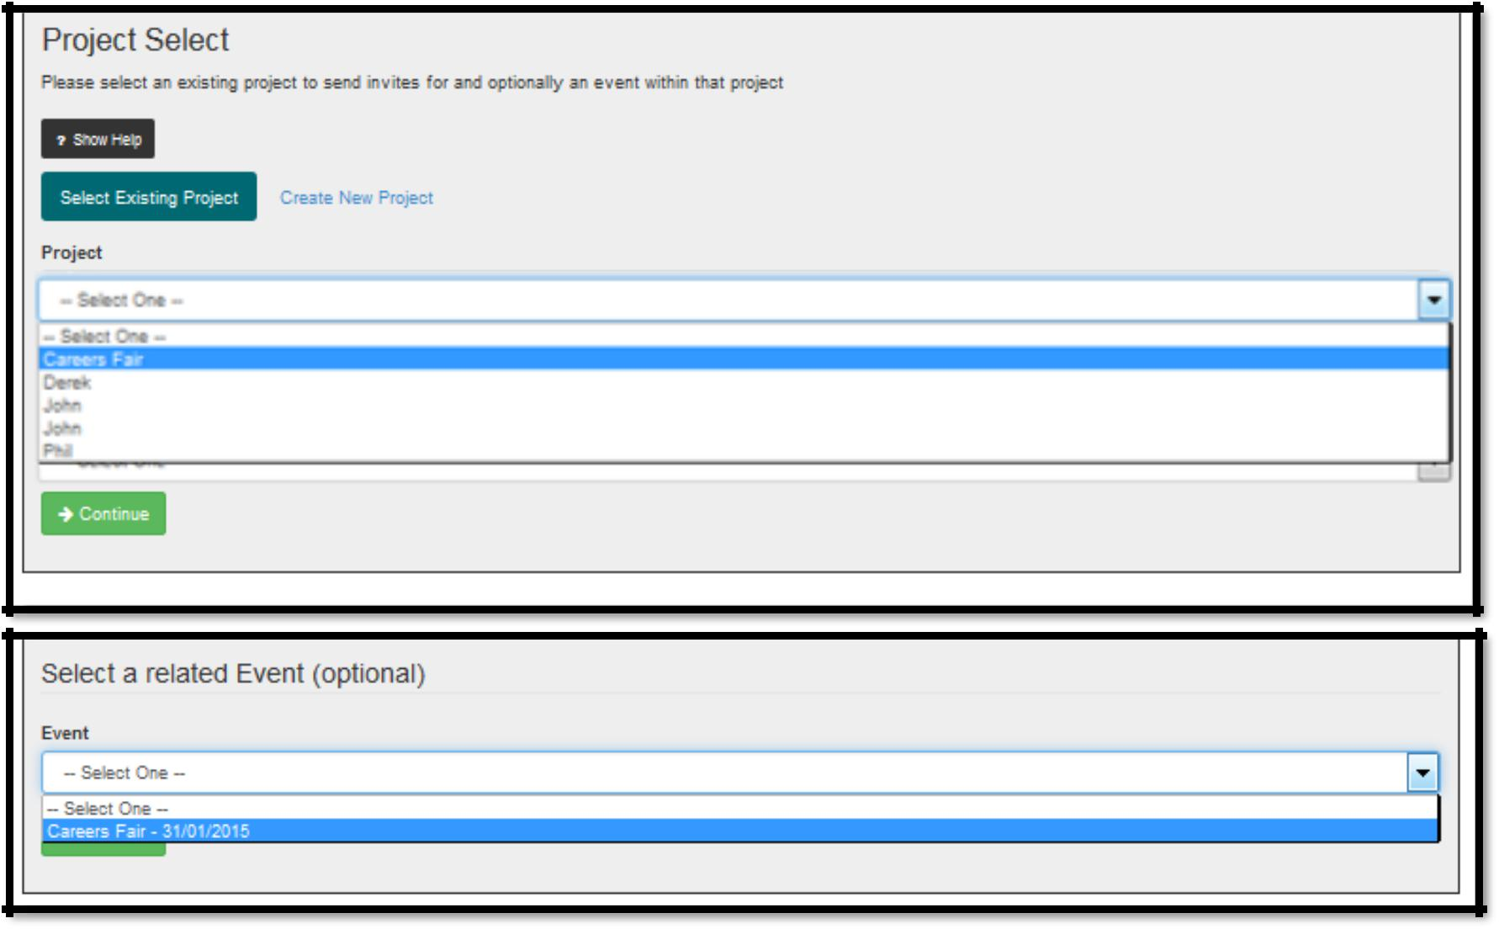
Adding Volunteers to an existing Project/Event

Slide 24
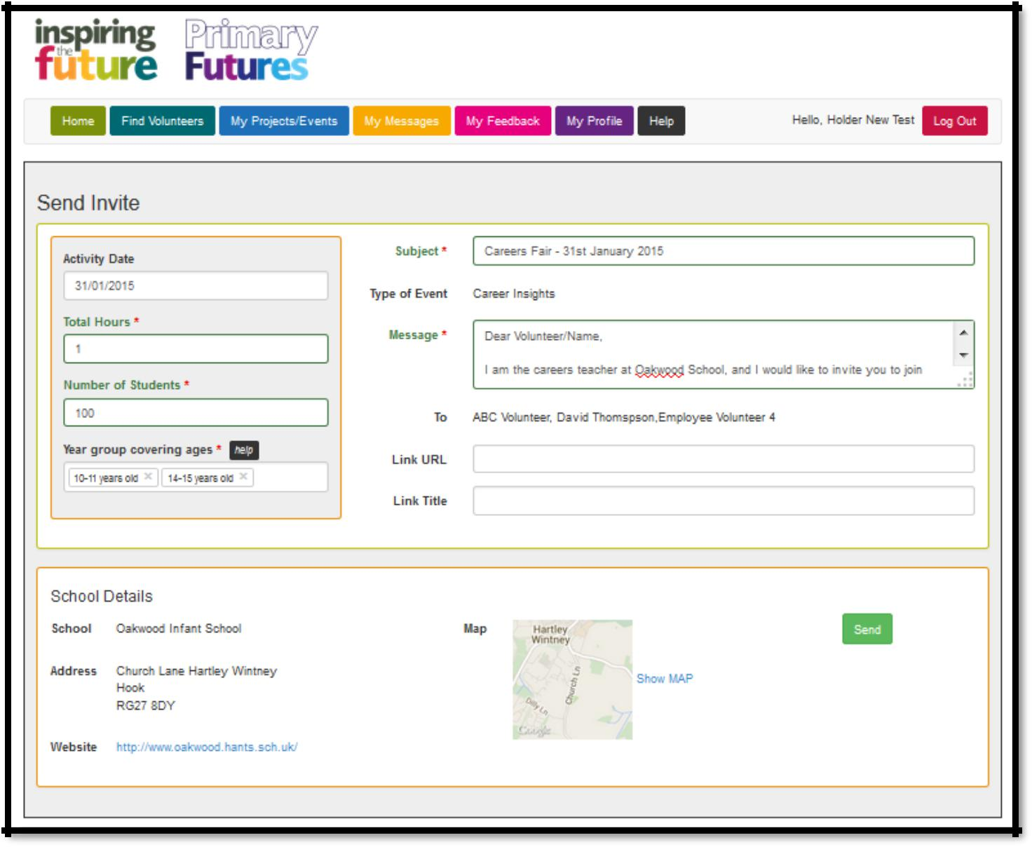
Invite selected Volunteers

Slide 25
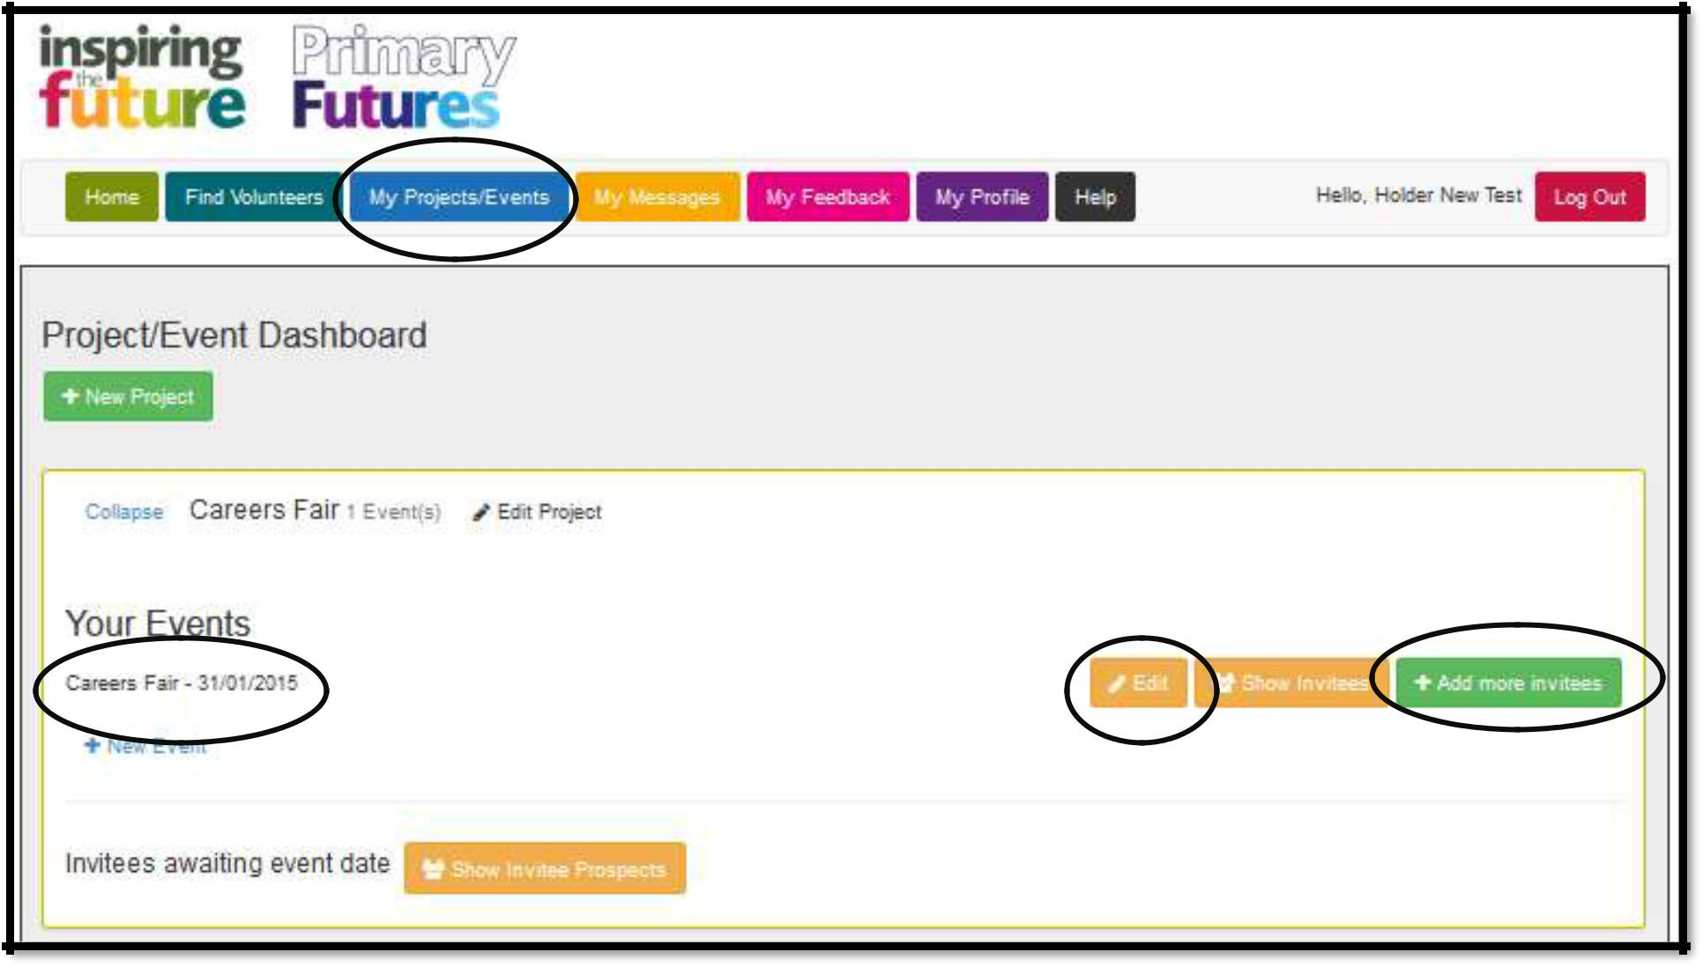
My Projects/Events
You have the ability to edit the event details or invite more volunteers if needed.

Slide 26
Receiving a message
Once your message has been sent, your chosen volunteer will be notified.
When they reply, you will be notified by email and asked to log in to your profile. You’ll see the new message on your home page, in the ‘My Messages’ section. To view the reply simply click on the message subject.

Slide 27
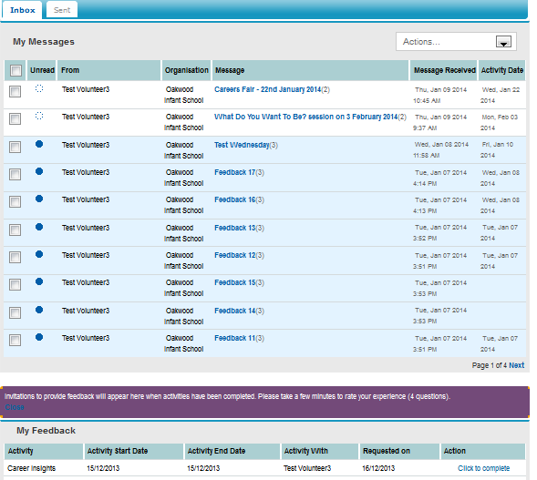
Completing your feedback
24 hours after the event takes place, you will get an email notifications asking you to log in and complete the ‘My Feedback’ section of the home page.
Simply click on the ’Click to complete’ link.

Slide 28
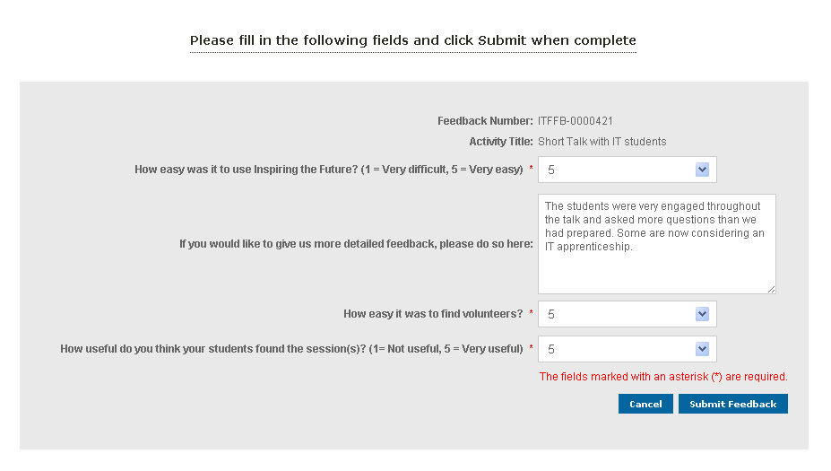
Completing your feedback
Once you have completed the relevant sections, click on the ‘Submit Feedback’ button, and you’ll be taken back to the home page to find your next volunteer!

Slide 29
Key Contacts
Name | Job Title | Email Address | Telephone Number
Adrian Rhodes | Director – Inspiring the Future Australia | Adrian@schoolsindustry.com.au
Ian Palmer | CEO - Schools Industry Partnership | Ian@schoolsindustry.com.au
Terry Bruce | Administration Co-ordinator | Terry@schoolsindustry.com.au
Ngaire Gardiner | Director-Communications | Ngaire@schoolsindustry.com.au

Slide 30
Any Questions?

